Slide 1
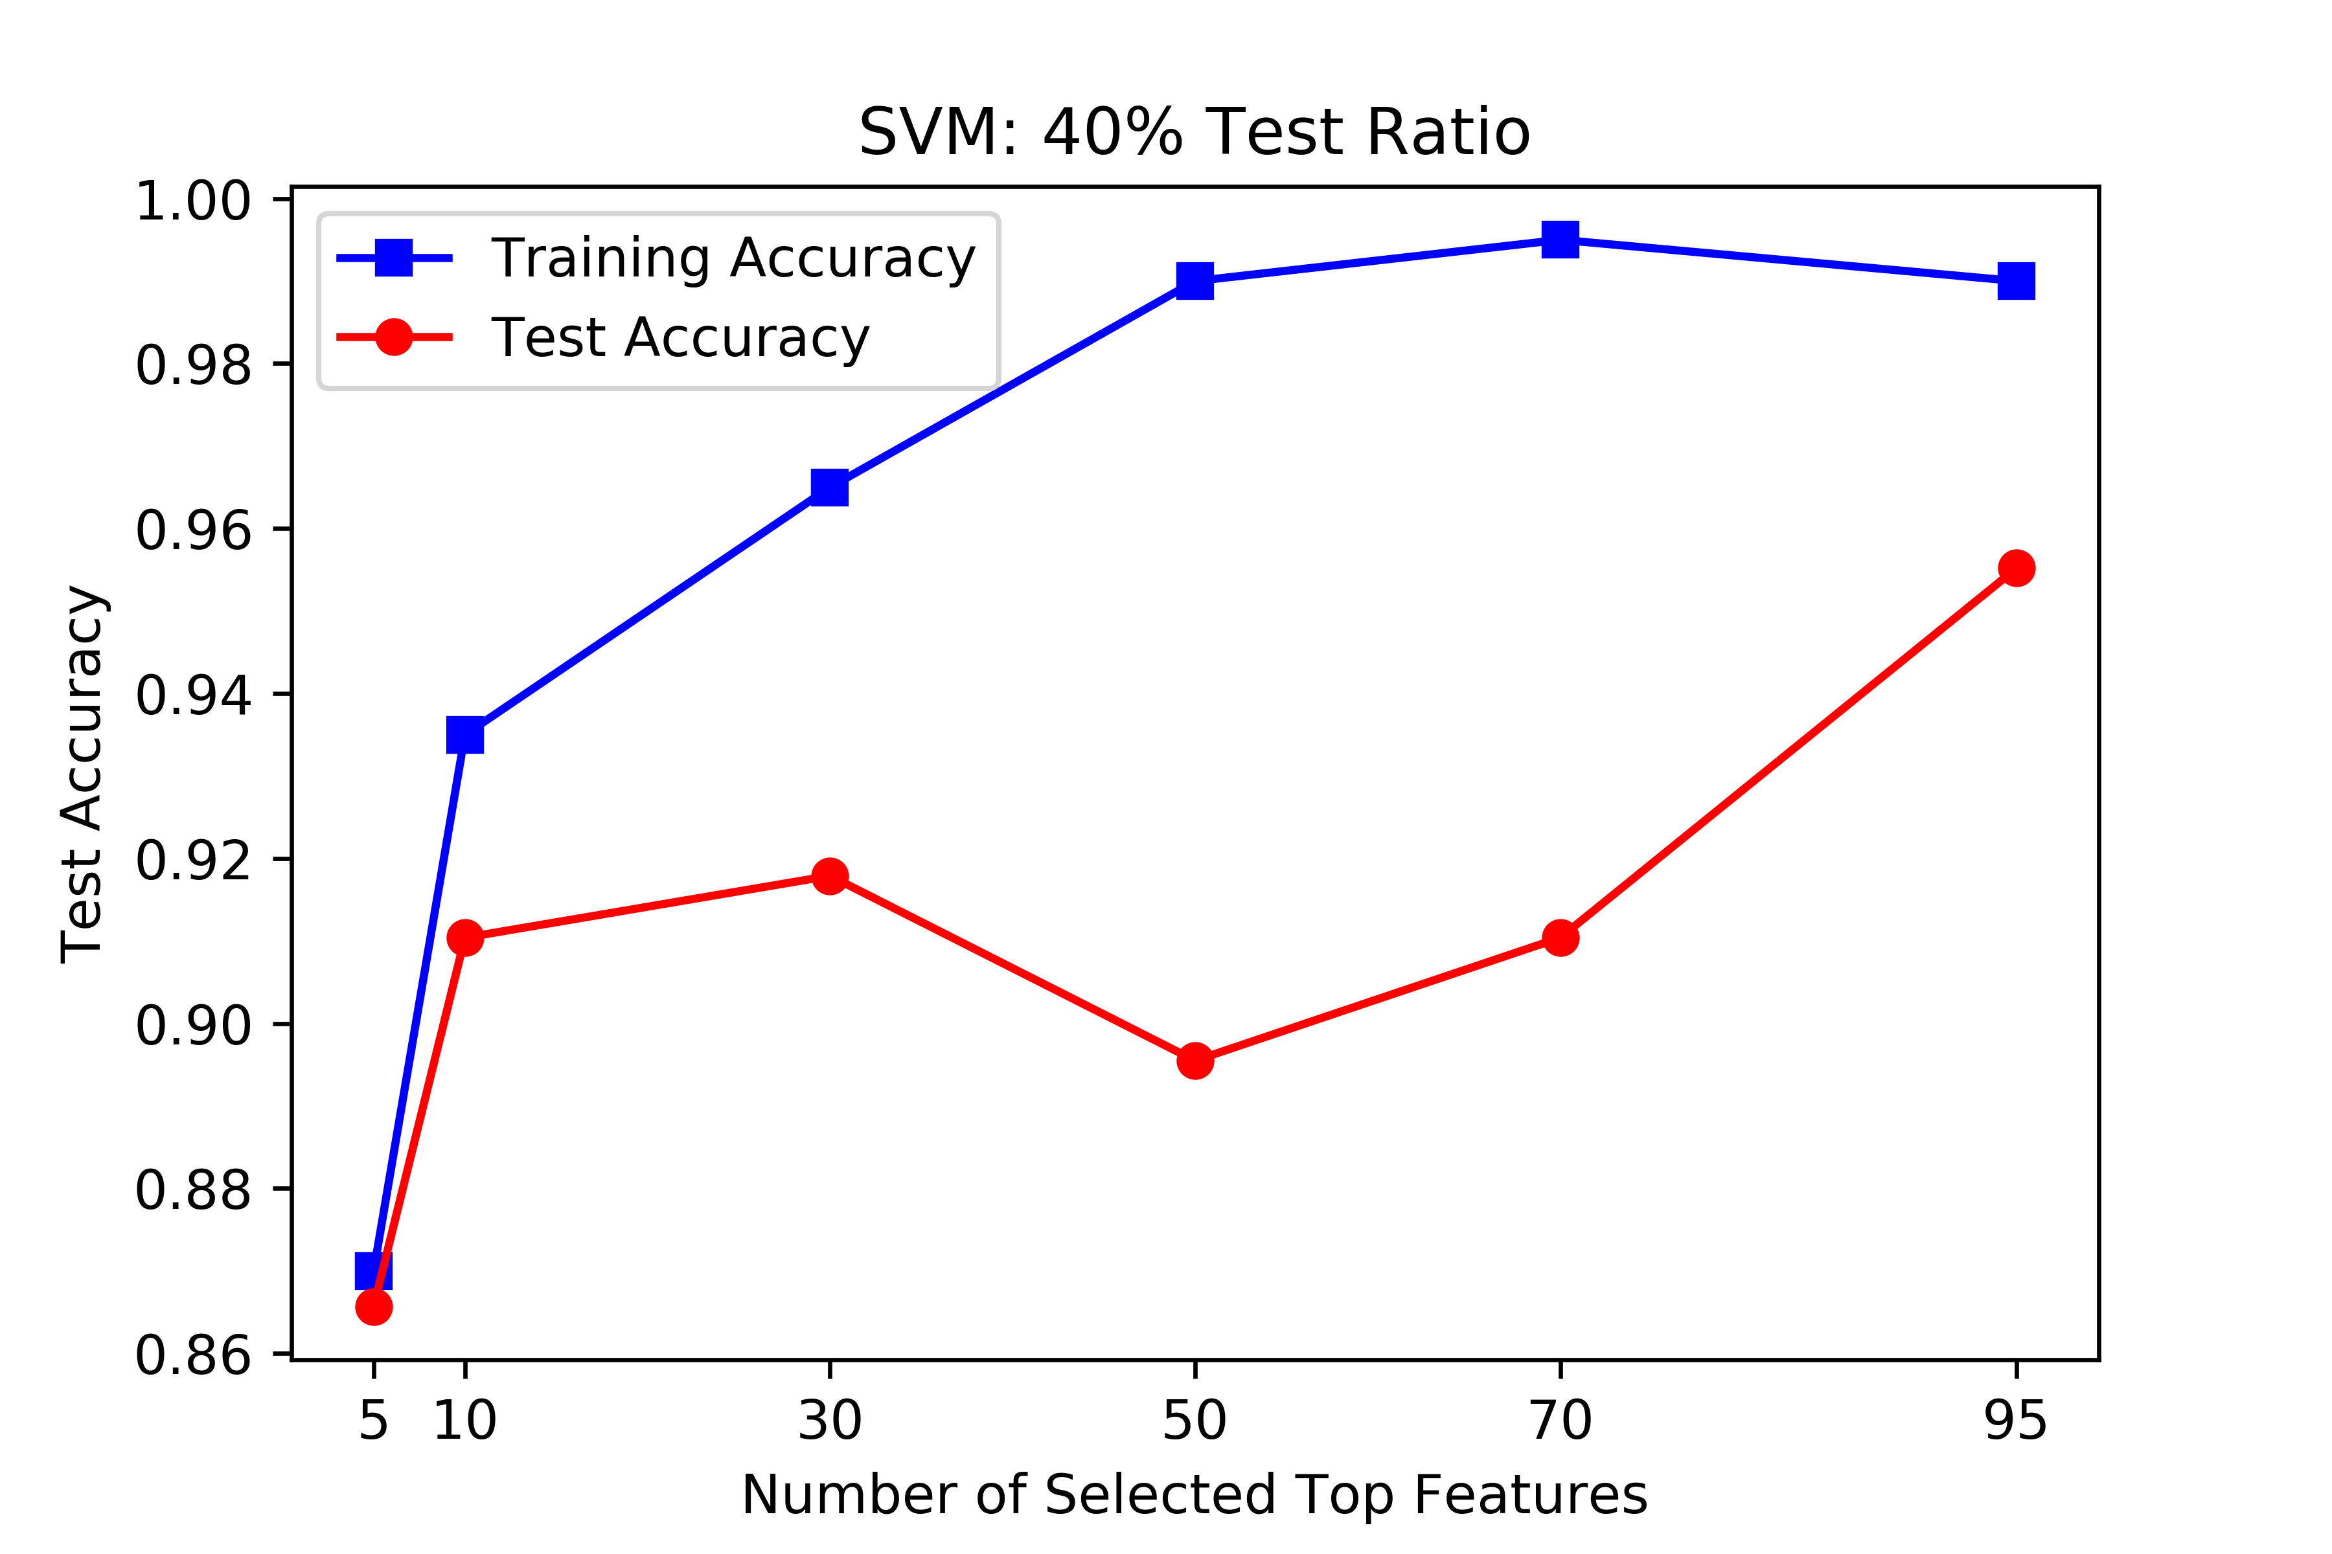
Age Detection
Young vs Old | 44 vs 290 = 1 vs 7
Base Profiles | Random Guess | All Old | All Young
Accuracy | 0.5000 | 0.8683 | 0.1317
Maximum number of features can be extracted by HSIC Lasso: 95 (out of 400K)
Testing Set: 40% of the original dataset
Best Testing Accuracy: 0.9552

Slide 2
Clustering Analysis

